Slide 1
Geographic Information System

Slide 2
Contents
Definition of GIS
Key components of GIS
Functional Subsystems

Slide 3
What is Geographical Information System?

Slide 4
What is GIS
Combination of three words
G
I
S
Stands for Geographical Information System

Slide 5
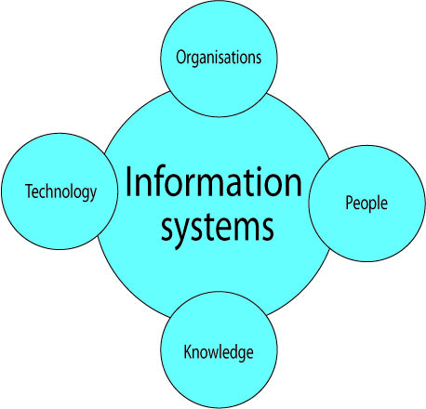
Information System A system that collects, store, maintains, processes data and provides information to people.

Slide 6
Geographical Information System
It is a system of hardware and software used for collecting, storing, retrieving, analyzing and displaying geographic data or Spatial data.

Slide 7
GIS Data Types
•Spatial Data
Describes the absolute location and relative location of the geographic features.
All data that pertains to location on earth is known as spatial data
•Attribute Data
Describes the characteristics of geographic features.
Attribute data is represented and stored in the form of tables.

Slide 8
Components of GIS

Slide 9
Components
Hardware
Software
People
Data
Methods

Slide 11
Hardware
Sufficient memory to store large volume of data,
High resolution color screen
Keyboard, plotter or printer mouse etc.

Slide 12
Software
Functions and tools needed to store, analyzed and display
Tools for entering and manipulation geographic information such as political boundaries
Database management system designed to store , retrieve and update data
Tools that create intelligent digital maps for analysis
Software components must be able to input, verify, store, manage, analyze out put present and transform data efficiently.

Slide 13
SOftware
Arc view
Arc GIS
Arc Info
Map Info
IILWIS
IRDAS
ER Mapper

Slide 14
Data
Spatial data (Address, zip code and district number)
Attribute or non spatial data ( Depth, Height,
agricultural production)
Spatial data paper maps, charts and drawing scanned or digitized in to the system.
Co ordinate data recorded using a GPS receiver and data captured from satellite imagery or Aerial photography are also sources of spatial data.
Sources of attribute data include database, work flow, and any other form of computer system .

Slide 15
User
Who plans, implements and operate the system and make decisions based on the analyzed results
User can be categorized into viewers, general user and GIS specialist.
GIS specialist are responsible for the maintenance of the geographic database and the provision of techniques support to the other two classes of user

Slide 16
Methods
How data will be retrieved input in to system, stored managed analyzed and finally presented in a form of output.
Perform analysis for differentiates this type of system from any other information system

Slide 17
Functions
Generation of Graphic Display
Representing Desired Information

